Slide 1
Unit 2 : Control Statements

Slide 2
Control Statements
Python provides special constructs to control the execution of one or more statements depending on a condition. Such constructs are called as control statements or control-flow statements.
The control-flow statements are of three types: Selection Statement - is a statement whose execution results in a choice being made as to which of two or more paths should be followed.
if construct
if-else construct
if-elif-else construct
Nested if-elif-else construct

Slide 3
Iterative Statement - is a statement which executes a set of statements repeatedly depending on a condition.
while loop
for loop
else clause on loop statements
Control flow Statement - is a statement which transfers control-flow to some other section of the program based on a condition.
break statement
continue statement
pass statement

Slide 4
The general syntax of if statement in Python is,
If test expression:
statement(s)
The if-construct is a selection statement, the statements within the block are executed only once when the condition evaluates to True, Otherwise the control goes to the first statement after the if-construct.
In Python, the body (block of statements) of the If statement is indicated by indentation.
The body starts with indentation and the first unindented line marks the end.
Python interprets non-zero values as True. None and 0 are interpreted as False.

Slide 5
Example
num = int(input("Enter a number: "))
if (num % 3 == 0):
print("Given number %d is divisible by 3" %num) # Notice the Indentation
print("End of program")

Slide 6
Practice Program
Write a program to check whether a number is divisible by 3 and 5.
Write a program is input an account balance and if account balance is less than 5000 then alert the user that ‘ Account balance is low’.

Slide 7
The if-else statement provides two different paths of execution depending on the result of the condition. The body of if is executed when the condition associated with the expression is true.
The body of else part is executed when the condition is evaluated to false. Indentation is used to separate both the if and else blocks.
Below is the general syntax for the if-else statement
if(expression):
body of If
else:
body of else

Slide 8
Take an integer as input from the console using input() function. Write a program to check the given input amount is greater or less than the minimum balance. Follow the given instructions while writing the program and print the output as shown in the example. Assume minimum balance is 1000
If input >= 1000 print Sufficient balance
Otherwise the message should print on the console is Balance is Low

Slide 9
Program Practice
Write a program to check whether a number is even or odd.
Write a program to find greater of 2 numbers.

Slide 10
if-elif-else construct
The if-elif-else construct extends the if-else construct by allowing to chain multiple if constructs as shown below:
Syntax: if test expression:
﻿﻿﻿﻿﻿body of if
elif test expression:
body of elif
...
elif test expression:
body of elif
else:
body of else
The if elif else construct is used when we have multiple mutually exclusive expressions.
If the condition for if is false, then the condition for the next elif is evaluated and so on upto the next elif.
If all the conditions are false, then the body of else is executed.
Only one block among if elif else blocks is executed based on the condition.
The if block can have only one else block, but it can have multiple elif blocks.
Indentation is used for each of the if-elif-else blocks

Slide 11
Take an integer num as input from the console using input() function. Write a program to check the given num is a positive, a negative one or Zero, print the result to the console as shown in the examples.
Take an integer year as input from the console using input() function. Write a program to check the given year is a leap year or not, print the result to the console as shown in the examples.

Slide 12
Write a program to input a vowel and check whether that character is vowel or not.
Write a program to find greatest of 3 numbers
Write a program to take an input in a variable and check whether it is digit, uppercase or lowercase letter.

Slide 13
Loops : while loop
Syntax of while loop in Python:
while test expression:
body of while
A while statement is used to execute some block of code repeatedly as long as a condition evaluates to True.
In the While loop, the value of the expression is evaluated first.
The body of the loop is entered only when the expression evaluates to true.
After one iteration, the expression is checked again.
This process continues until the expression evaluates to False.
The body of the loop is identified using the indentation with the expression condition as the first statement.

Slide 14
While loop with else
We can have an optional else block with while loop as well.
The else part is executed if the condition in the while loop evaluates to False.
The while loop can be terminated with a break statement. In such a case, the else part is ignored.
Hence, a while loop's else part runs if no break occurs and the condition is False.

Slide 15
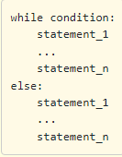

Slide 16
Write a program to print the numbers from 1 to 10 using while loop.
# use of while loop
i=1
while i<=10:
print(i)
i=i+1

Slide 17
Take an integer num as input from the user. Write a code to find sum of all even numbers upto num using while construct, print the result to the console as shown in the example.
Write a program to print all the even number from 1 to n. Where n can be taken as input from user.

Slide 18
Write a program to print first ‘n’ Fibonacci terms using while loop where ‘n’ can be taken as input from user.
Write a program to print sum of first ‘n’ Fibonacci terms where ‘n’ can be taken as input from user.
Write a program to find factorial of a number ‘n’ where ‘n’ should be taken as input from user.

Slide 19
For loop
A for-loop is used to iterate over a range of values using a loop counter, which is a variable taking a range of values in some orderly sequence (e.g., starting at 0 and ending at 10 in increments of 1). The value stored in a loop counter is changed with each iteration of the loop, providing a unique value for each individual iteration. The loop counter is used to decide when to terminate the loop.
A for-loop construct can be termed as an entry controlled loop. For loop Syntax:
for val in sequence:
Body of for
Here val is the variable that takes the value of the item in the sequence for each iteration.
The Loop continues until the last item in the sequence is reached.
The body of the for loop is separated from the rest of the code using indentation.

Slide 20
# use of for loop
for i in range(10):
print(i)

Slide 21
# use of for loop
for i in "python":
print(i)

Slide 22
Write a program to count the number of vowels in a string using for loop. String can be taken as input from the user.

Slide 23
The range() function : We can generate a sequence of numbers using range() function.
We can use the range() function in for loop to iterate through a sequence of numbers.
It can be combined with the len() function to iterate through a sequence using indexing.
Syntax:1. range(stop) :
Returns a sequence of numbers starting from 0 to (stop - 1)
Returns an empty sequence if stop is negative or 0.
range(6) will generate numbers from 0 to 5 (up to 6 not including 6).

Slide 24
Let us consider a simple example:
for i in range(1, 6):
print(i)

Slide 25
Take an integer n from the user using input() function. Write a program to print the the value of Pi up to n decimals. Print the result as shown in the example.

Slide 26
For loop with else
A for loop can have an optional else block as well.
The else part is executed if the items in the sequence used in for-loop exhausts.
A break statement can be used to stop a for-loop. In such case, the else part is ignored.
Hence, a for-loop's else part runs if no break occurs.
A common construct to search for an item is to use a for-loop which can terminate in two scenarios,
If the item is found and a break is encountered, exit out of the for-loop.
If the item is not found, then the loop completes.

Slide 27
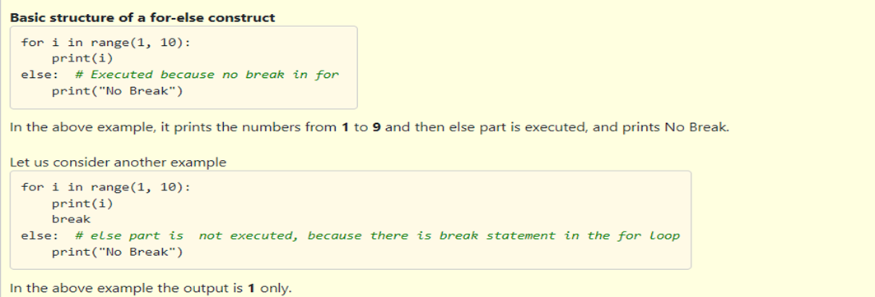

Slide 28
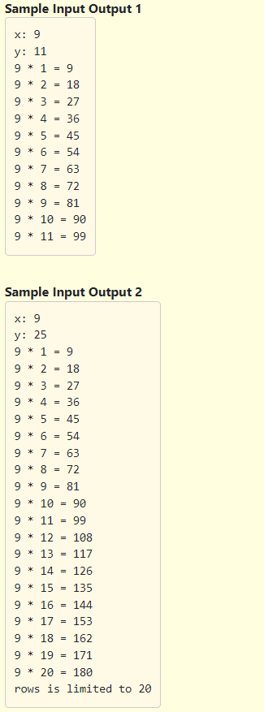
Practice Question 3
Fill in the missing code in the program below to print a multiplication table up to a maximum of 20 rows. Even if the number of rows asked by the user is more than 20, we should limit up to 20 rows and print an error message as shown in the Sample Input Output 2.

Slide 29
# Multiplication table
x = int(input("x: "))
y = int(input("y: "))
# Fill in the missing code below to print a multiplication table for x upto y rows.
# If y is more than 20, print the relevant message as per instructions and limit the number of rows to 20
if y>20:
for i in range(1, 21):
print(x, "*", i, "=", x * i)
else:
print("rows is limited to 20")
else:
for i in range(1, y + 1):
print(x, "*", i, "=", x * i)

Slide 30
Nested loops
A loop can be nested inside another loop.
Nested loops consist of an outer loop and one or more inner loops. Each time the outer loop is repeated, the inner loops are reentered and started again.

Slide 31
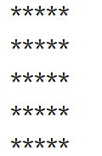
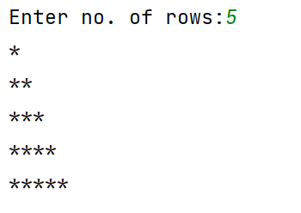
for i in range(1,6):
for j in range(1,6):
print("*",end='')
print()
n=int(input("Enter no. of rows:"))
for i in range(1,n+1):
for j in range(1,i+1):
print("*",end='')
print()

Slide 32
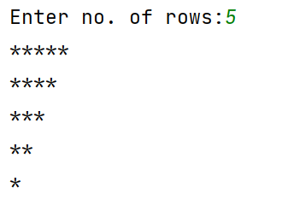
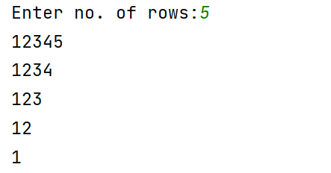
n=int(input("Enter no. of rows:"))
for i in range(n,0,-1):
for j in range(1,i+1):
print("*",end='')
print()
n=int(input("Enter no. of rows:"))
for i in range(n,0,-1):
for j in range(1,i+1):
print(j,end='')
print()

Slide 33
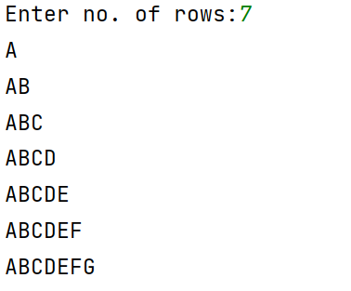
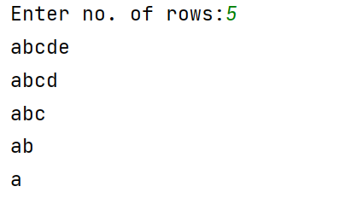
val=65
n=int(input("Enter no. of rows:"))
for i in range(1,n+1):
for j in range(1,i+1):
print(chr(val),end='')
val=val+1
val=65
print()
val=97
n=int(input("Enter no. of rows:"))
for i in range(n,0,-1):
for j in range(1,i+1):
print(chr(val),end='')
val=val+1
val=97
print()

Slide 34
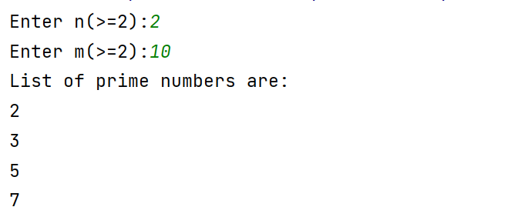
Display all prime number from n to m
flag = 0
n = int(input("Enter n(>=2):"))
m = int(input("Enter m(>=2):"))
print("List of prime numbers are:")
for i in range(n, m + 1):
for j in range(2, (i // 2)+1):
if i % j == 0:
flag = 1
if flag == 0:
print(i)
flag = 0

Slide 35
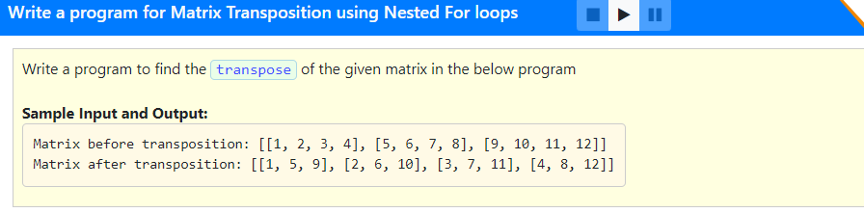

Slide 36
Solution:
matrix = [[1, 2, 3, 4], [5, 6, 7, 8], [9, 10, 11, 12]]
matrix1=[[0,0,0],[0,0,0],[0,0,0],[0,0,0]]
print("matrix:",matrix)
# find the transpose of the matrix and print the result as shown in the example above
for i in range(3):
for j in range(4):
matrix1[j][i]=matrix[i][j]
print("transposed:",matrix1)

Slide 37
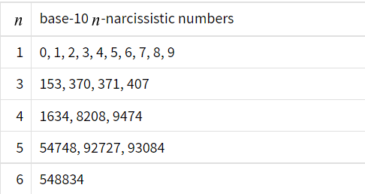
More Questions to do:
WAP to display the sum of digits of a number
WAP to count digits of a number
WAP to display reverse of a number
WAP to check whether the given number is palindrome or not?
WAP to check whether the given number is armstrong or not( or narcissistic number)?
WAP to check whether the given number is prime or composite?
WAP to display factorial of a number
WAP to display n terms of Fibonacci series

Slide 38
More Questions to do:
WAP to display all palindromic numbers from n to m
WAP to display reverse of all even numbers from n to m
WAP to display all perfect numbers from n to m
WAP to display all even list elements from the following list:
list1=[[1,2,3],[4,5,6],[7,8,9]]

